Slide 1

RepuScore™
Greg
Angela
Navkar
Shivam
Mana
Charles
Vasco

Slide 2
Introduction
RepuScore™
Problem : How to trust AI transaction Agents
Solution : Create a trust logic RepuScore, for an Agentic transaction to identify trustworthy/risky agents
Impact : Secure, Reliable and Truthful transactions, process optimization and customer satisfaction

Slide 3
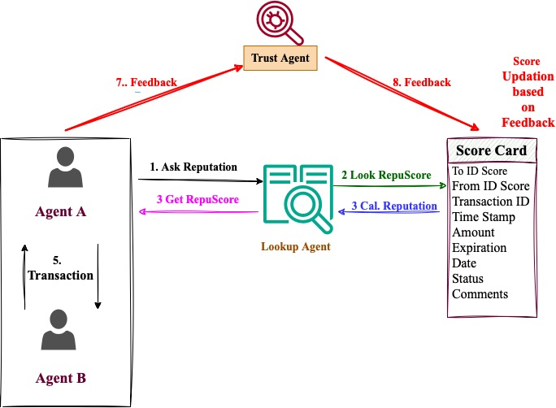
Solution Workflow
RepuScore™

Slide 4
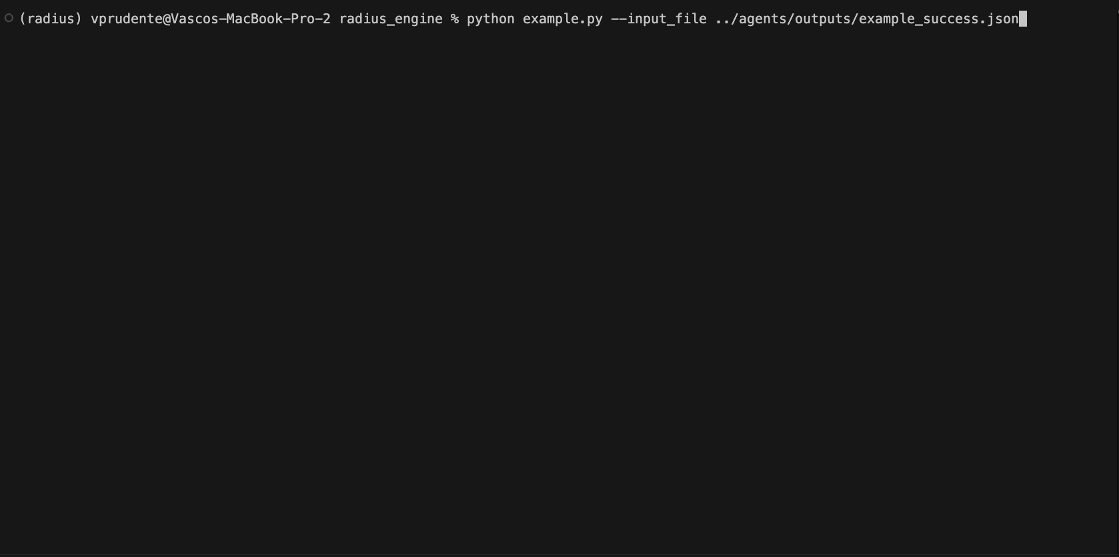
RepuScore Back End
RepuScore™

Slide 5
Business Model- Monetization
RepuScore™
Extra fees for trusted counterparties especially for large clients with big volume of transactions
Develop a full RepuScore product and API licensing
Charge risk-adjusted premiums based on trustworthiness scores for insurance-backed transactions.

